Slide 1
Predicted Influences on Failure of Secondary students ages (15-22)

Slide 2
Supervised Machine Learning Models Used
Logistics Regression
Ridge Regression
Random Forest
Naïve Bayes
Dataset from https://archive.ics.uci.edu/ml/datasets/student+performance by
P. Cortez and A. Silva. Using Data Mining to Predict Secondary School Student Performance

Slide 3
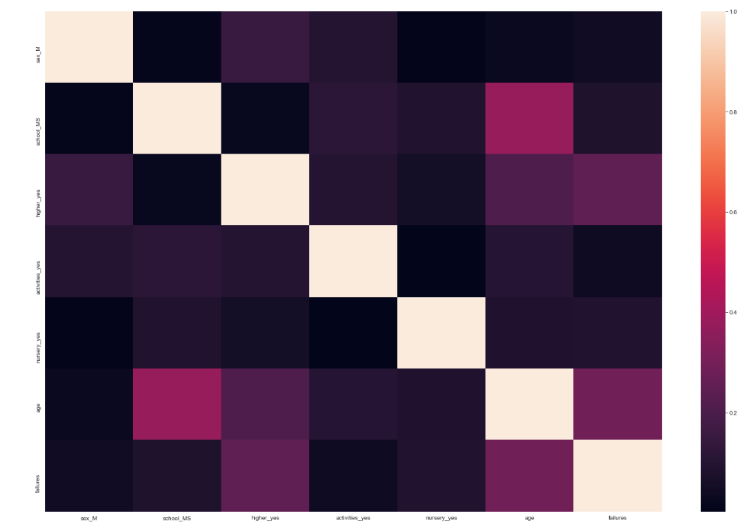
Features chosen from the dataset after cleaning
Sex (Male)
School (MS)
Desire for Higher Education (YES)
After school activities (YES)
Age
Failures

Slide 4
Supervised Learning Models with Outputs
Logistics Regression
Summary of the model
Confusion Matrix
Cross Val Score
F1 Score Accuracy
Ridge Logistics Regression
Ridge Model Score
Confusion Matrix
Cross Val Score
Random Forest
Random Forest model score
Confusion Matrix
Naïve Bayes
NB Model Score
Confusion Matrix
F1 Accuracy Score
Cross Val Score
F1 Accuracy Score
Model Feature importance’s
Cross Val Score
F1 Accuracy Score

Slide 5
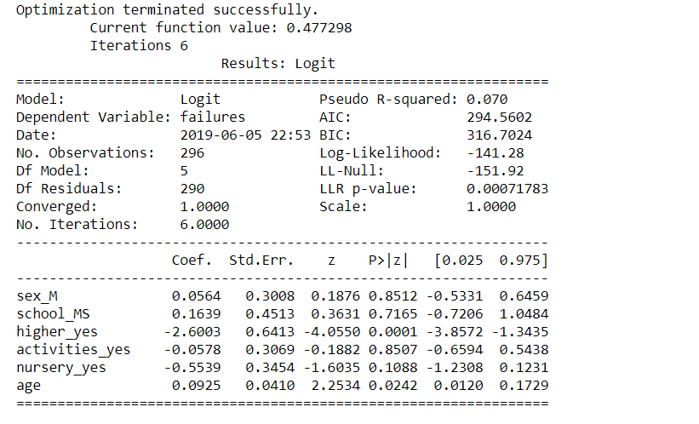



Logistic Regression Model

Slide 6
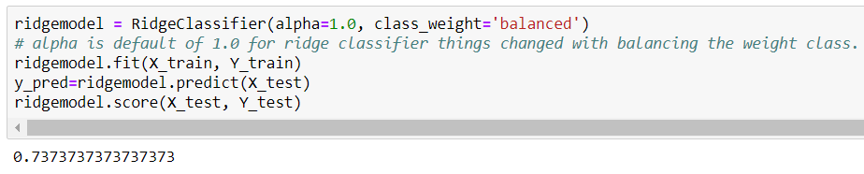



Ridge Regression Model

Slide 7
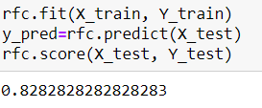



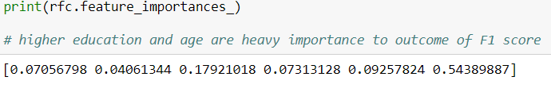
Random Forest Model

Slide 8
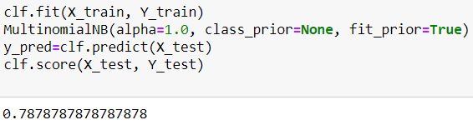



Naïve Bayes Model

Slide 9
F1 Score Comparison and Findings
The best F1 score was with Random forest
Feature importance’s was heaviest from age and desire for higher education in the random forest model
Results are based on positive for failures
Model | Model Score | F1 Score
Logistics Regression | 0.04 | 0.4
Ridge Regression | 0.73 | 0.480
Random Forest | 0.82 | 0.514
Naïve Bayes | 0.78 | 0.0

Slide 10
Summary of exploring the dataset
During the process of discovery of the dataset. I have found that the random forest model did the best in the F1 Accuracy Score 0.514 and the confusion matrix was good at 73 and 9 on the true negative and true positive (indicating failure) and 12 and 5 on the false negative and false positive (indicating no failure). The failures feature used labeling on the 1, along with 25 percent of the dataset as the test model. The failures feature was binarized with a threshold of 1. I used feature importance's as a relevant method to find how it was weighted against the accuracy of the model
It was discovered that features age and desire for higher education had the largest weight of the group of features that were chosen. In the logistics regression model the directionality of the two features was in opposite directions on the z. I chose these two features to look at due to their influence in the summary. Given the opportunity and knowing about these two features I found it surprising and something to continue to look at maybe with another dataset given the same features looking at influences in the model.

